Slide 1

THE RIM, INC.
THE RIM, INC.
THE RIM IS
WHERE YOU WANNA BE.
THE RIM IS
WHERE YOU WANNA BE.
A founder-led entertainment and IP company. Swipe brings in the audience. The Rim turns that attention into a portfolio of original properties.
A founder-led entertainment and IP company. Swipe brings in the audience. The Rim turns that attention into a portfolio of original properties.
$250K RAISE
12 MONTHS
LOS ANGELES
$250K RAISE
12 MONTHS
LOS ANGELES
THE RIM, INC. • INVESTOR DECK v3.0 • CONFIDENTIAL
01
THE RIM, INC. • INVESTOR DECK v3.0 • CONFIDENTIAL

Slide 2
01 • INVESTMENT THESIS
Build the audience. Prove the transfer. Expand what earns demand.
Swipe acquires attention. The Rim turns proven attention into company-controlled IP.
1 • CAPTURE
2 • TRANSFER
3 • EXPAND
Build Swipe into a recognizable artist and personality through consistent content, a clear visual identity, music, and paid distribution.
Use RMRADIO, “Did You Know?” and recurring lore to move audience interest from Swipe into The Rim.
Launch characters, media, licensing, and consumer products after audience demand is clear.
YEAR-1 TEST: Does Swipe’s audience follow independent Rim properties?
THE RIM, INC. • INVESTOR DECK v3.0 • CONFIDENTIAL
02

Slide 3
02 • FLAGSHIP TALENT
Meet Swipe
A stylized founder alter ego built for music, fashion, personality, and constant real-world content.
THE PERSONA
THE LOOK
THE MUSIC
Expressive, optimistic, impulsive, and social. Confident in public. Unlucky in love.
Spiky hair. Skatewear by day. High fashion when the moment calls for it. Pearls, studded bracelets, and statement belts replace standard rapper status cues.
12 released songs. Cameron wrote, produced, performed, and recorded the catalog himself. Capital improves packaging, distribution, and promotion.
FIRST IMPRESSION KPI: “This guy has style.”
THE RIM, INC. • INVESTOR DECK v3.0 • CONFIDENTIAL
03

Slide 4
03 • EARLY PROOF
Verified traction evidence
Founder-provided platform screenshots dated Aug. 24–27, 2026 show organic reach plus early paid-to-music conversion testing.
1.2M+
9,375
813
32
views on a TikTok post*
Instagram views / 30 days*
Hypeddit visits*
Hypeddit music clicks*
Organic short-form has produced multiple five- and six-figure TikTok posts, including a 1.2M-view post. Instagram reached 9,375 views and 2,322 viewers in the prior 30 days, with 44.9% of views from non-followers. Hypeddit grew to 813 visits and 32 clicks by Aug. 27.
Paid test evidence: Meta snapshot shows $43.72 spend, 4,509 reach and 4,688 impressions; a reporting view shows 41 link clicks at $1.51 CPC. Spotify snapshot on Aug. 27 shows 171 streams in the prior 28 days. *Screenshots dated Aug. 24–27, 2026; refresh again immediately before sending.
THE RIM, INC. • INVESTOR DECK v3.1 • CONFIDENTIAL
04

Slide 5

04 • THE WORLD
04 • THE WORLD
The Rim
The Rim
A heightened neo-1980s America where excess, old media, new technology, and absurd institutions exist side by side. The characters treat it all as normal.
A heightened neo-1980s America where excess, old media, new technology, and absurd institutions exist side by side. The characters treat it all as normal.
NO FIXED YEAR
TECH HAS NO CEILING
DEATH IS OPTIONAL
AMERICANA × SATIRE
NO FIXED YEAR
TECH HAS NO CEILING
DEATH IS OPTIONAL
AMERICANA × SATIRE
THE RULE
THE TONE
THE RULE
Smartphones, monster trucks, airbrushed ads, extreme wealth, aliens, and old-school media coexist. To the people of The Rim, this is ordinary life.
Smartphones, monster trucks, airbrushed ads, extreme wealth, aliens, and old-school media coexist. To the people of The Rim, this is ordinary life.
The Rim borrows the look of America’s late-20th-century boom years, pushes the excess further, and uses the result for social commentary.
THE TONE
The Rim borrows the look of America’s late-20th-century boom years, pushes the excess further, and uses the result for social commentary.
THE RIM IS WHERE YOU WANNA BE.
THE RIM IS WHERE YOU WANNA BE.
THE RIM, INC. • INVESTOR DECK v3.0 • CONFIDENTIAL
05

Slide 6


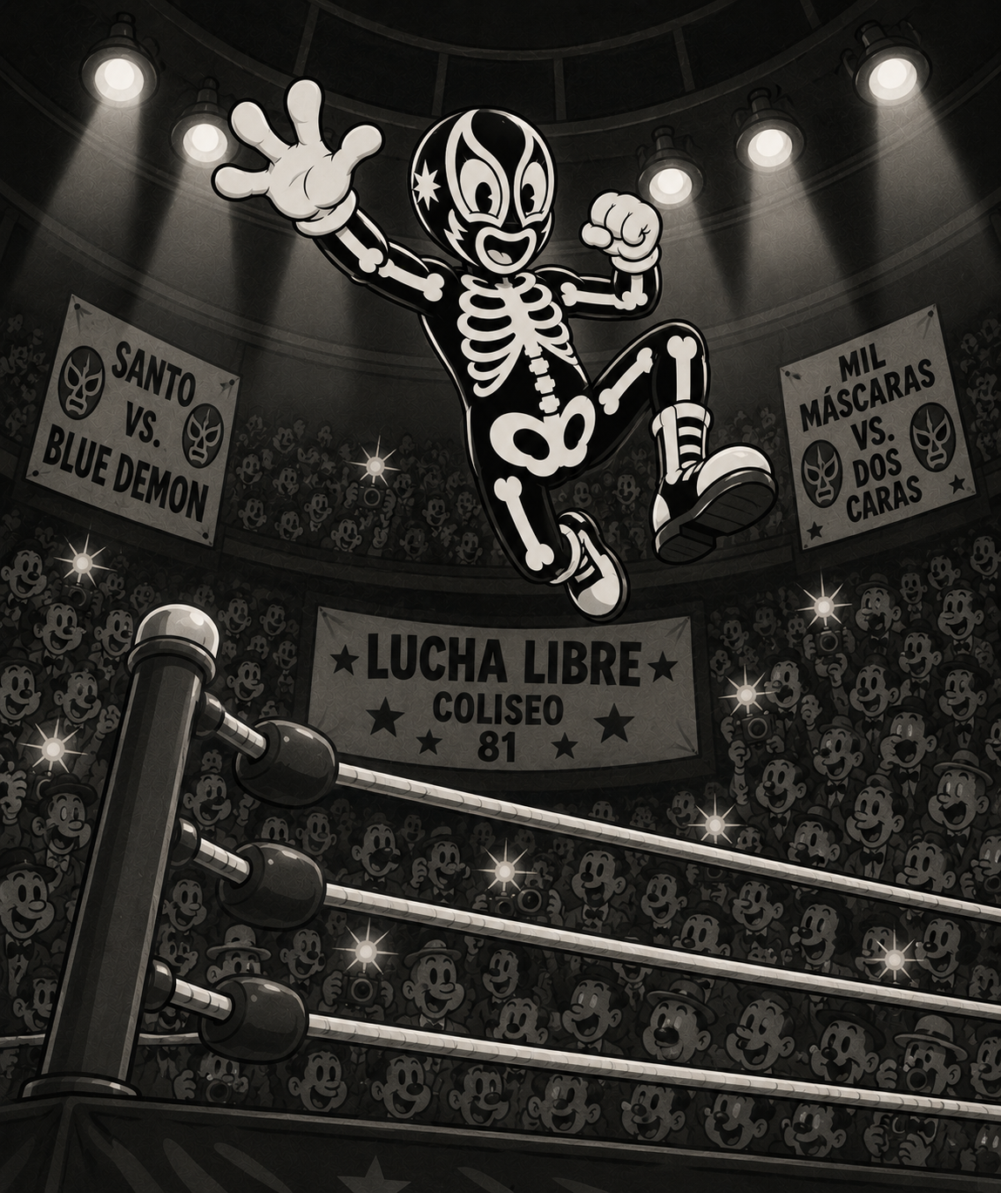



05 • IP PORTFOLIO
One world. Multiple properties.
The portfolio starts with talent, media, characters, institutions, and fictional brands. Proven demand opens the path to real products and licensed extensions.
RMRADIO
MODERN MAN
EL MAS BARRACO
World news / sports / ads / music
Undefeatable straight-edge hurdler
Undefeated humanitarian luchador
GEEKS N FREEKS
DR. HELIO
RUN
Four-monster college band gone global
Idiot chemist who once cured cancer
100% graduation-rate flagship university
BURPEES
CATCH UP
DID YOU KNOW?
Carbonated candy-bar institution
Modern Man’s sports drink
Short-form facts that establish canon
THE RIM, INC. • INVESTOR DECK v3.0 • CONFIDENTIAL
06

Slide 7
06 • AUDIENCE JOURNEY
How the audience enters The Rim
Introduce the world through repeated details. Let the audience connect Swipe to a larger system over time.
1
2
3
4
5
SWIPE
→
CURIOSITY
→
RMRADIO
→
LORE
→
TRANSFER
Personality, fashion, music, livestreams
Recurring references create a pattern
News reports events beyond Swipe
Did You Know? + background artifacts
Fans care about Rim properties without Swipe
TARGET SHIFT: “Who is Swipe?” → “What is The Rim?” → “What happens next?”
THE RIM, INC. • INVESTOR DECK v3.0 • CONFIDENTIAL
07

Slide 8
07 • CONTENT ENGINE
Capture daily life. Publish with intent.
The team captures Swipe’s daily life and turns the strongest moments into a steady content pipeline.
CAPTURE
INGEST
CLIP
RIMIFY
AMPLIFY
An embedded camera operator captures Swipe throughout the day.
Footage is archived, tagged and searchable.
Editors pull the strongest personality, fashion, music, and comedy moments.
A separate edit adds RMRADIO, lore, and in-world details.
Paid media supports posts with strong organic performance.
CAPTURE DOES NOT EQUAL PUBLISH. The founder sets privacy limits and holds final creative approval.
THE RIM, INC. • INVESTOR DECK v3.0 • CONFIDENTIAL
08

Slide 9
08 • BUSINESS MODEL
Monetize Swipe first. Expand The Rim with demand.
Revenue begins with Swipe. Supporting IP enters commerce after audience demand is proven.
YEAR-1 REVENUE
LATER EXPANSION
RIMIFICATION RULE
Rimified brand partnerships • sponsorships • music/streaming • appearances • selective Swipe merchandise • platform/creator revenue
Licensing • character merchandise • RMRADIO • consumer products • live experiences • music from Rim acts
Real brands enter The Rim through RMRADIO, Did You Know?, fictional events, and in-world scenarios. The Rim retains creative control.
PARTNERSHIP BOUNDARY: Swipe remains intentionally nonpartisan. Exclusivity is narrow and paid for. Swipe access does not equal portfolio rights.
THE RIM, INC. • INVESTOR DECK v3.0 • CONFIDENTIAL
09

Slide 10
09 • 12-MONTH MILESTONES
Build → Pull → Transfer → Decide
Year 1 tests one core model: build Swipe, measure audience pull, prove transfer into RMRADIO, then make an evidence-based capital decision.
MONTH 3
BUILD
MONTH 6
PULL
MONTH 9
TRANSFER
MONTH 12
DECIDE
Professional Swipe identity • LA operation • core content team • 7–14 day reserve • priority designs/logos • Rim Bible v1.0
Unsolicited Swipe recognition • RMRADIO / Did You Know? curiosity • direct-audience growth • commercial response • next-financing assessment
Test RMRADIO as an independent media property. Measure standalone attention, retention, follows, and audience behavior when Swipe is absent.
EXPAND if growth, transfer, and commercial evidence repeat. ITERATE if the thesis is promising but incomplete. RESET if the strategy fails to produce durable demand.
THE RIM, INC. • INVESTOR DECK v3.0 • CONFIDENTIAL
10

Slide 11
10 • CAPITAL PLAN
$250,000 • 12-month proof plan
Capital builds the acquisition engine, professionalizes the IP, tests transfer, and preserves a protected reserve. Discretionary spend scales only after proof.
Founder compensation
$36K
Rim visual / IP development
$20K
Fractional COO
$24K
Swipe image development
$15K
Embedded cameraman
$35K
Legal / IP / accounting
$10K
Editing + content production
$40K
HQ / production infrastructure
$15K
Marketing + paid distribution
$35K
Swipe music
$5K
PROTECTED RESERVE $15K • TOTAL $250K • PAID MEDIA STARTS WITH ~$5–7.5K TEST AUTHORITY; MORE SPEND UNLOCKS AFTER PROOF.
THE RIM, INC. • INVESTOR DECK v3.0 • CONFIDENTIAL
11

Slide 12
11 • THE RAISE
Seeking $250K from a strategic lead investor
Preferred investor: one lead with entertainment, music, fashion, consumer, media, creator, agency, distribution, or future-capital leverage.
WORKING ECONOMICS
STRATEGIC VALUE
FOUNDER ALIGNMENT
$250K for 10% target ownership. Final structure and terms remain subject to diligence, negotiation, and securities/corporate counsel.
Capital plus introductions, operating guidance, brand access, creator networks, distribution relationships, and future financing leverage.
Founder-led creative control. 75% personal ownership floor on a fully diluted basis. Three-seat board target: founder, lead investor, mutually agreed independent.
Instrument, valuation, investor rights, option-pool timing, board mechanics, and protective provisions will be finalized with qualified securities/corporate counsel before accepting capital.
THE RIM, INC. • INVESTOR DECK v3.0 • CONFIDENTIAL
12

Slide 13

12 • VALUE CREATION
Swipe is the doorway.
The Rim is the company.
The 12-month value inflection is evidence that attention around one person transfers into company-controlled IP.
AUDIENCE ENGINE
RMRADIO TRANSFER
DIRECT AUDIENCE
REPEATABLE REVENUE
Daily system
Independent demand
Owned relationship
Commercial proof
Build the audience. Prove the transfer. Expand what earns demand.
THE RIM, INC. • INVESTOR DECK v3.0 • CONFIDENTIAL

